Slide 1
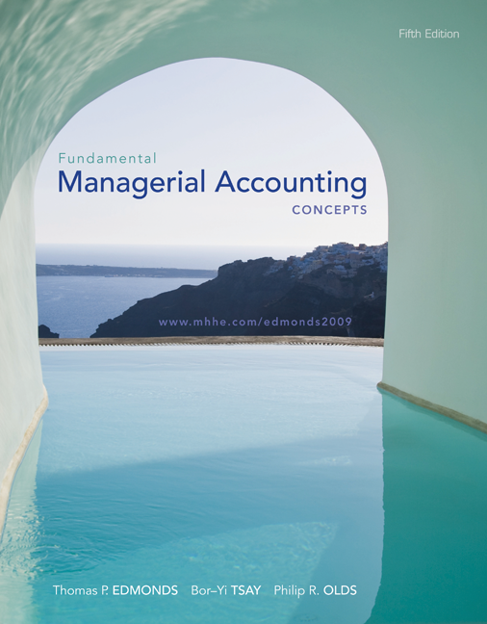
Fifth Edition
Fundamental Managerial Accounting Concepts
Thomas P. Edmonds
Bor-Yi Tsay
Philip R. Olds
Copyright © 2009 by The McGraw-Hill Companies, Inc. All rights reserved.
McGraw-Hill/Irwin
Notes:
Fundamental Managerial Accounting Concepts Fifth Edition
Thomas P. Edmonds, Bor-Yi Tsay, and Phillip R. Olds

Slide 2
Chapter One
Management Accounting:
A Value-Added Discipline
Notes:
In this course you will learn about the types of accounting information used by those internal in a company. Much of the information generated by management accounting systems is proprietary information not available to the public. Since this information is not distributed to the public, it need not be regulated to protect the public interest. Management accounting is restricted only by the value-added principle. Management accountants are free to engage in any information gathering and reporting activity so long as the activity adds value in excess of its cost.

Slide 3
Differences Between Managerial and Financial Accounting

Slide 4
Differences Between Managerial and Financial Accounting

Slide 5
Product Costing
Managers need to know the cost of products to help . . .
Set the selling price of the product.
(cost + pricing)
Control costs within the organization.
Properly determine inventory costs.

Slide 6
Product Costs in Manufacturing Companies
Materials
Labor
Overhead
Notes:
Part I
The cost of making products includes the cost of materials, labor and other resources (usually called overhead).
Part II
Let’s assume that Tabor Manufacturing Company makes wooden tables. For Tabor, materials would include the lumber used for the tables. The labor would be the cost of the carpentry workforce that converts the lumber into tables. Overhead would include utilities used to help manufacture the tables.

Slide 7
Direct Material
Raw material that is used to make,
and can be conveniently
traced, to the finished product.
Example:
Steel used to
manufacture
the automobile.

Slide 8
Direct Labor
Cost of salaries, wages, and fringe
benefits for personnel who work
directly on manufactured products.
Example:
Wages paid to an
automobile assembly
worker.

Slide 9
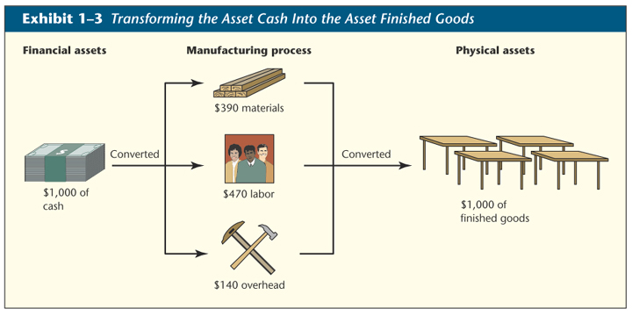
Insert Exhibit 1-3 Here
Notes:
This exhibit illustrates how cash is transformed into inventory. As you can see from this example, the one thousand dollars in cash is used to buy lumber, pay for labor, and pay for overhead costs. Ultimately, it is converted into one thousand dollars worth of tables. The cost of the tables is held in an asset account called Finished Goods.

Slide 10
Average Cost per Unit
Total Cost
Number of Units
= Average Cost per Unit
Tabor Example Average Cost Per Unit
$1,000
4
= $250
Notes:
Part I
How much did each table cost? The average cost per unit is calculated as the total cost divided by the number of units.
Part II
For our Tabor Manufacturing Company, the average cost per unit for the tables is two hundred fifty dollars.

Slide 11
Costs Can Be Assets or Expenses
Cost Category
Balance Sheet
Income Statement
$1,000
Product Costs
Materials
Labor
Tools
$1,000
Cost of
Finished
Goods
$750
Cost of
Good Sold
$250
Products Not
Sold (Ending
Inventory
$200
Selling and
Administrative
Costs
$200
Selling and
Administrative
Costs

Slide 12
Flow of Material Costs
Balance Sheet
Income Statement
Material
Costs
Cost of
Goods Sold
Inventory

Slide 13
Flow of Labor Costs
Balance Sheet
Income Statement
Production
Wages
Cost of
Goods Sold
Inventory
Labor
Costs
Selling and
Administrative
Salaries
Salary
Expense

Slide 14
Flow of Depreciation Charges
Balance Sheet
Income Statement
Depreciation on
Manufacturing
Equipment
Cost of
Goods Sold
Inventory
Overhead
Costs
Depreciation on
Office
Equipment
Depreciation
Expense

Slide 15
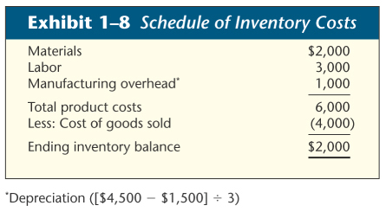
Total Product Cost
Insert Exhibit 1-8 Here
Notes:
Here is a summary of Patillo Manufacturing’s total product cost.

Slide 16
Overhead Costs - A Closer Look
Cost that cannot be traced to products and services in a cost effective manner are called indirect costs and are part of manufacturing overhead.
Depreciation on
Manufacturing
Assets
Factory
Utilities
Rent on
Manufacturing
Facilities
Indirect
Materials
Indirect
Labor
Supervisor’s
Salary
Manufacturing Overhead

Slide 17
Manufacturing Overhead
All other manufacturing costs
Indirect
Material
Indirect
Labor
Other
Costs
Materials used to support the production process. Examples: lubricants and cleaning supplies used in an automobile assembly plant.

Slide 18
Manufacturing Overhead
All other manufacturing costs
Indirect
Material
Indirect
Labor
Other
Costs
Cost of personnel who do not work directly on the product. Examples: maintenance workers, janitors and security guards.

Slide 19
Manufacturing Overhead
All other manufacturing costs
Indirect
Material
Indirect
Labor
Other
Costs
Examples: depreciation on plant and equipment, property taxes, insurance, utilities, overtime premium, and unavoidable idle time.
See Exhibit 1-11 on page 12

Slide 20
Overhead Costs - A Closer Look
Since indirect costs cannot be traced to products, they are normally allocated to the product in a reasonable manner.
Allocation
Rate
Total Manufacturing Overhead
Relevant Activity
=

Slide 21
Cost Allocation
Allocation rate:
$120 ÷ 8 = $15
per labor hour

Slide 22
Manufacturing Product Cost Summary
Direct
Materials
Direct
Labor
Manufacturing
Overhead*
Product Costs
* Indirect materials
Indirect labor

Slide 23
Importance of Cost Classification
Everyone interested in a company’s financial statements will be concerned with how costs are classified.
I guess you know that the
amount of total assets and
net income will be higher if
a cost is classified as an
asset than if it is expensed.

Slide 24
Importance of Cost Classification
The financial statement impact of cost classification may impact both the availability of financing and motivation of management.
Efficient
Markets
Hypothesis
Creditors and investors look to the substance of business events regardless of how the transactions are reported in the financial statements.

Slide 25
Ethical Considerations
Users must be able to trust information provided by accountants.
Management accountants are governed by a code of ethics issued by the Institute of Management Accountants (IMA).

Slide 26
Standards of Ethical Conduct for Management Accountants
Competence
Confidentiality
Integrity
Objectivity (Credibility)
Resolution of Ethical Conflict

Slide 27
Standards of Ethical Conduct for Management Accountants
Follow applicable laws, regulations and standards.
Maintain professional competence.
Competence
Prepare complete and clear reports after appropriate analysis.

Slide 28
Standards of Ethical Conduct for Management Accountants
Do not disclose confidential information unless legally obligated to do so.
Do not use confidential information for personal advantage.
Confidentiality
Ensure that subordinates do not disclose confidential information.

Slide 29
Standards of Ethical Conduct for Management Accountants
Avoid conflicts of interest and advise others of potential conflicts.
Do not subvert organization’s legitimate objectives.
Integrity
Recognize and communicate personal and professional limitations.

Slide 30
Standards of Ethical Conduct for Management Accountants
Avoid activities that could affect your ability to perform duties.
Refrain from activities that could discredit the profession.
Refuse gifts or favors that might influence
behavior.
Integrity
Communicate unfavorable as well as favorable information.

Slide 31
Standards of Ethical Conduct for Management Accountants
Communicate information fairly and objectively.
Objectivity
Disclose all information that might be useful to management.

Slide 32
Upstream and Downstream Costs
These are NOT Product Costs
Downstream Costs incurred after the
manufacturing
process is complete.
Example:
Advertising.
Upstream Costs incurred before the
manufacturing
process begins.
Example:
R&D costs.
Profitability analysis requires close
attention to these costs as well as
manufacturing costs.

Slide 33
Total Quality Management (TQM)
A systematic problem-solving philosophy that encourages front-line workers to achieve zero defects.
An organizational commitment to achieving customer satisfaction.
Continuous Improvement

Slide 34

Activity-Based Management and Value-Added Assessment
An organization cannot manage costs. Instead, it manages the activities that cause costs to be incurred. Activities represent the measures an organization takes to accomplish its goals.
Notes:
An organization cannot manage costs. Instead, it manages the activities that cause costs to be incurred. Activities represent the measures an organization takes to accomplish its goals.
The sequence of activities used to provide products is called a value chain. A value added activity is any unit of work that contributes to a product’s ability to satisfy customer needs. Nonvalue added activities are tasks undertaken that do not contribute to a product’s ability to satisfy customer needs. For example, waiting for the oven to preheat so food can be cooked does not add value. Most customers value cooked food, but they do not value waiting for it.

Slide 35
Activity-Based Management
We manage activities that cause costs to be incurred.
A value-added activity is work that contributes to a product’s ability to satisfy customer needs.
Identify value-added and nonvalue-added activities.
Identify ways to reduce or eliminate
the nonvalue-added activities.

Slide 36
The Value Chain
Research and
Development
Obtain
Materials
Value-added activities
include all steps
involved in the actual
processing of goods or
performing of services.
Manufacturing
Marketing
Delivery

Slide 37
Just-in-Time
Many businesses have been able to simultaneously reduce their inventory holding costs and increase customer satisfaction by making products available just-in-time (JIT) for customer consumption.
Burger King vs. Frozen burgers
For example, hamburgers that are cooked to order are fresher and more individualized than those that are prepared in advance and stored until a customer orders one.
JIT
Notes:
37

Slide 38
Just-in-Time (JIT) Inventory
Receive
customer
orders.
Complete products
just in time to
ship to customers.
Schedule
production.
Receive materials
just in time for
production.
Complete parts
just in time for
assembly into products.

Slide 39
Just-in-Time (JIT) Inventory
Zero production
defects
Improved
plant layout
Flexible
workforce
Reduced
setup time
Most Favored Customer Status
Fewer, but more reliable suppliers.
Frequent JIT deliveries in small lots.
Defect-free supplier deliveries.

Slide 40
Just-in-Time (JIT) Inventory
Reduced
inventory
costs
Greater
customer
satisfaction
Higher quality
products
More rapid
response to
customer orders
Less warehouse
space needed

Slide 41
End of Chapter 1

